Slide 1
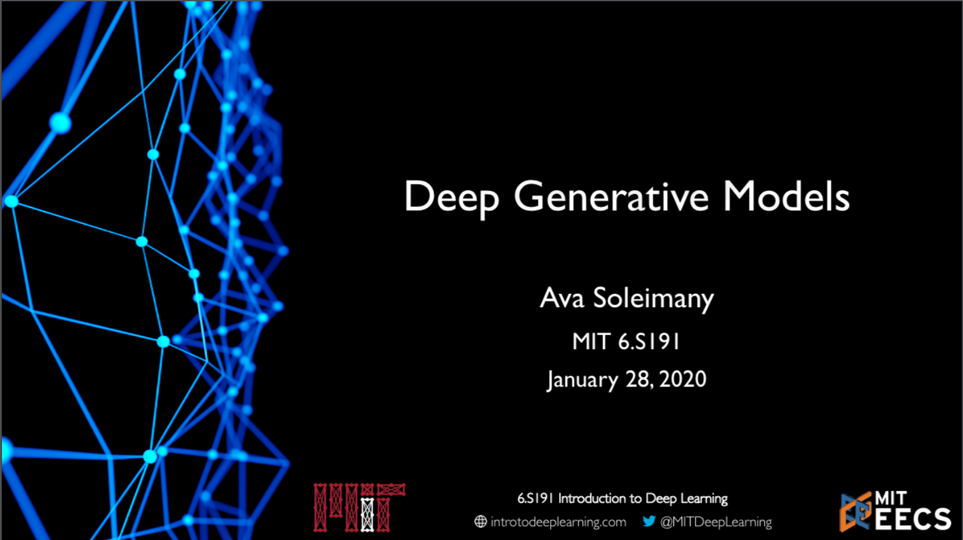

Slide 2
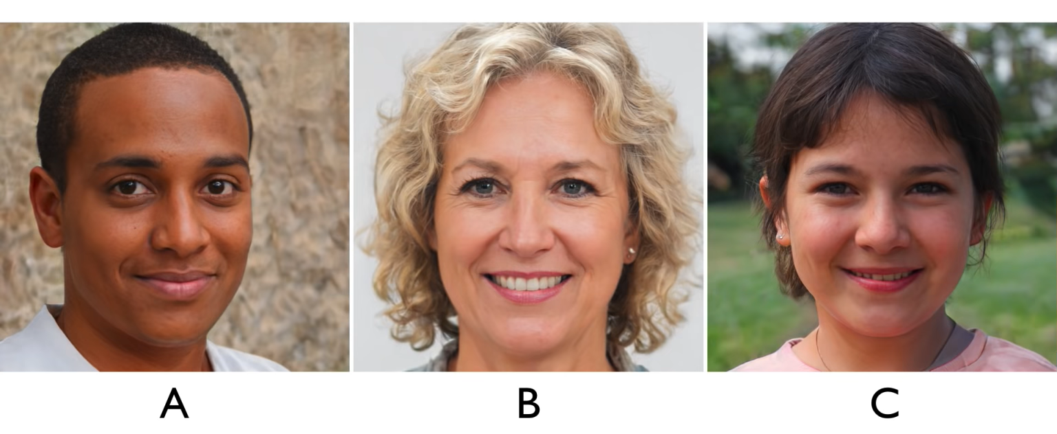
Which Face is fake?

Slide 3
Supervised VS Unsupervised Learning
Supervised Learning
Data: (x,y)
x is data, y is label
Goal: Learn function to map
x → y
Examples: Classification, regression, object detention, semantic segmentation, etc.
Unsupervised Learning
Data: x
x is data, no labels
Goal: Learn some hidden or underlying structure of the data
Examples: Clustering, feature or dimensionality reduction, etc.

Slide 4
Supervised VS Unsupervised Learning
Supervised Learning
Data: (x,y)
x is data, y is label
Goal: Learn function to map
x → y
Examples: Classification, regression, object detention, semantic segmentation, etc.
Unsupervised Learning
Data: x
x is data, no labels
Goal: Learn some hidden or underlying structure of the data
Examples: Clustering, feature or dimensionality reduction, etc.

Slide 5
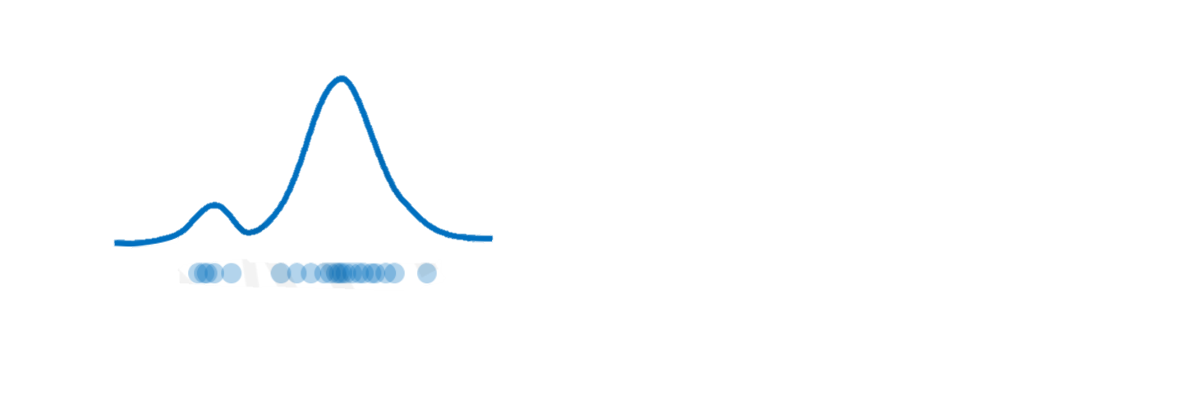
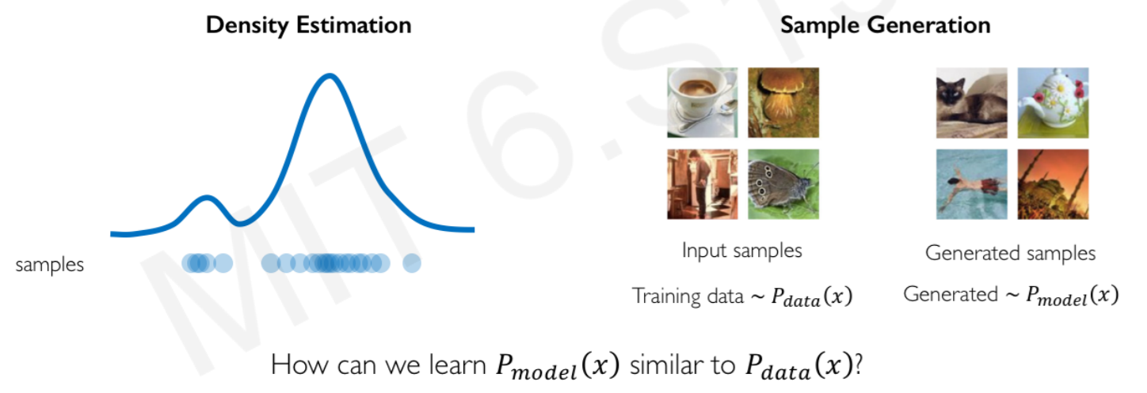
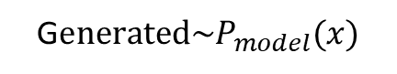
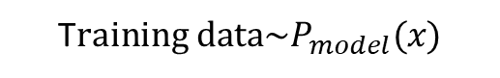
Generative modeling
Goal: Take as input training samples from some distribution and learn a model that represents that distribution
Density Estimation
Sample Generation
Input samples
Generated samples
samples
T$raining data{\sim P}_{model}(x)$
G$enerated{\sim P}_{model}(x)$
How can we learn $P_{model}(x)$ similar to $P_{data}(x)$?

Slide 6
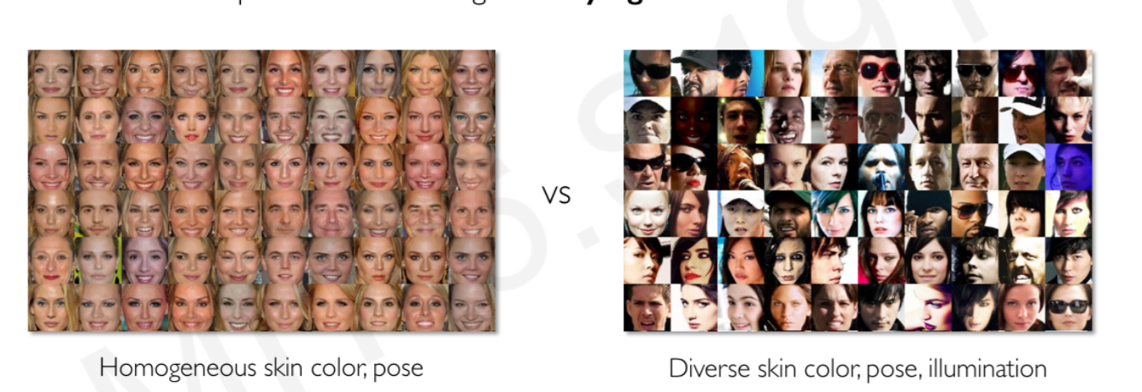
Why generative models? Debiasing
Capable of uncovering underlying features in a dataset
VS
Homogeneous skin color; pose
Diverse skin color; pose, illumination
How can we use this information to create fair and representative datasets?

Slide 7
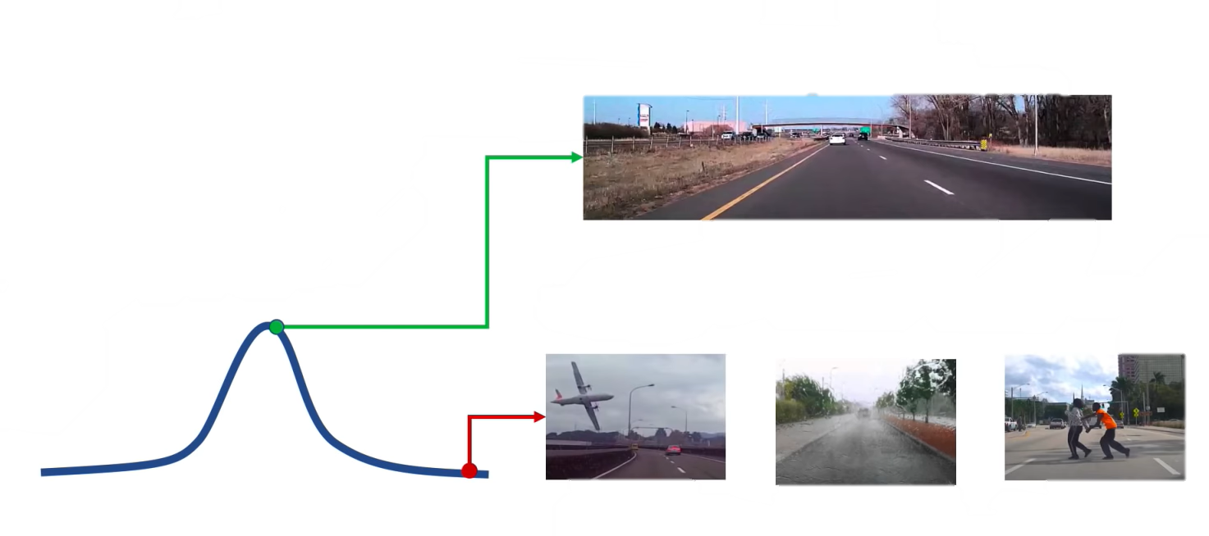
Why generative models? Outlier detection
95% of Driving Data:
Problem: How can we detect when we encounter something new or rare?
Strategy: Leverage generative models, detect outliers in distribution
Use outliers during training to improve even more
(1) sunny, (2) highway, (3) straight road
Detect outliers to avoid unpredictable behavior when training
Edge Cases
Harsh Weather
Pedestrians

Slide 8
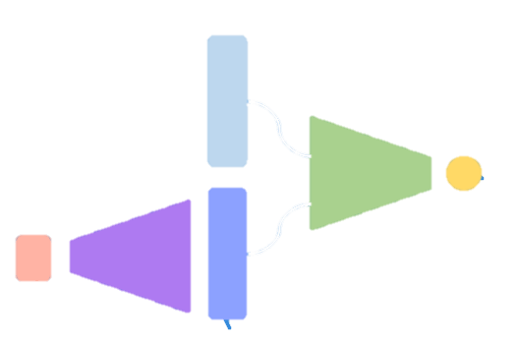
Latent variable models
Autoencoders and Variational Autoencoders (VAEs)
Generative Adversarial Networks (GANs)

Slide 9
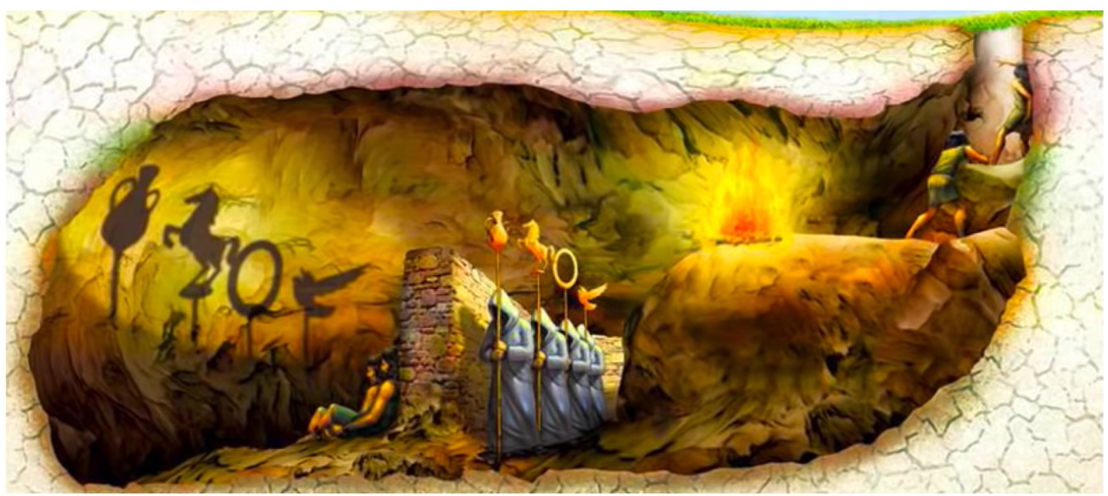
What is a latent variable?
Myth of the cave

Slide 10
What is a latent variable?
Can we learn the true explanatory factors, e.g. latent variables, from only observed data?

Slide 11
Autoencoders

Slide 12
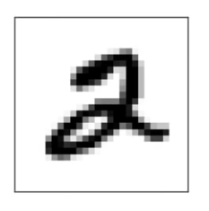
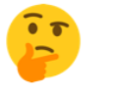
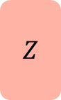

Autoencoders: background
Unsupervised approach for learning a lower-dimensional feature representation from unlabeled training data
$$x$$
Why do we care about a low-dimensional z?
$$Z$$
“Encoder” learns mapping from the data, x, to a low-dimensional latent space, z

Slide 13
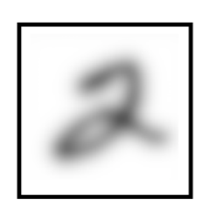

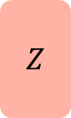

Autoencoders: background
How can we learn this latent space?
Trian the model to use these features to reconstruct the original data
$$x$$
$$x$$
$$Z$$
“Decoder” learns mapping back from latent, z, to a reconstructed observation, $\hat{x}$

Slide 14
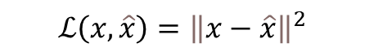
Autoencoders: background
How can we learn this latent space?
Trian the model to use these features to reconstruct the original data
$$x$$
$$x$$
$$Z$$
$$ℒ\left(x,\hat{x}\right)={\left\|x−\hat{x}\right\|}^{2}$$
Loss function doesn’t use any labels

Slide 15
Autoencoders: background
How can we learn this latent space?
Trian the model to use these features to reconstruct the original data
$$x$$
$$x$$
$$Z$$
$$ℒ\left(x,\hat{x}\right)={\left\|x−\hat{x}\right\|}^{2}$$
Loss function doesn’t use any labels

Slide 16
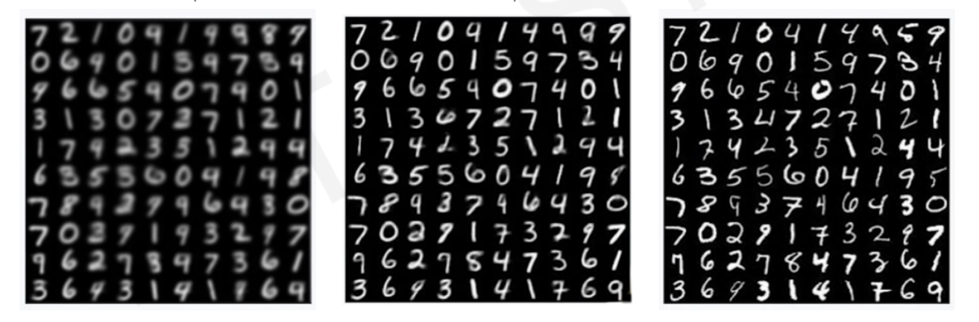
Dimensionality of latent space → reconstruction quality
Autoencoding is a form of compression.
Smaller latent space will force a larger training bottleneck.
2D latent space
3D latent space
Ground Truth

Slide 17
Autoencoders for representation learning
Bottleneck hidden layer forces network to learn a compressed latent representation
Reconstruction loss forces the latent representation to capture (or encode) as much “information” about the data as possible
Autoencoding = Automatically encoding data

Slide 18
Variational Autoencoders (VAEs)

Slide 19
Traditional autoencoders
$$x$$
$$x$$
$$Z$$

Slide 20
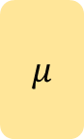
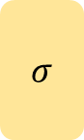
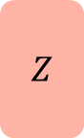
VAEs: key difference with traditional autoencoder
$$x$$
$$x$$
$$μ$$
$$Z$$
$$σ$$

Slide 21


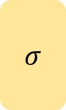

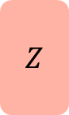
VAEs: key difference with traditional autoencoder
mean vector
$$x$$
$$x$$
$$μ$$
$$Z$$
$$σ$$
standard deviation vector
Variational autoencoders are a probabilistic twist on autoencoders.
Sample from the mean and standard dev. to compute latent sample

Slide 22
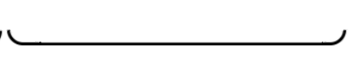
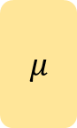

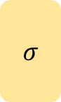

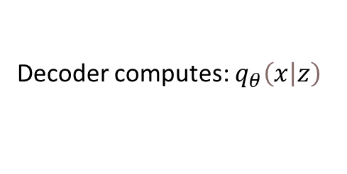
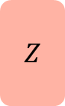
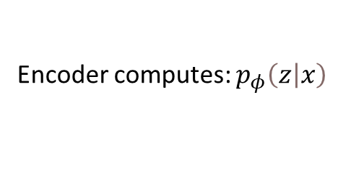
VAE optimization
$$x$$
$$x$$
$$μ$$
$$Z$$
$$σ$$
Encoder computes: $p_{φ}\left(\left.z\right|x\right)$
Decoder computes: $q_{θ}\left(\left.x\right|z\right)$

Slide 23
VAE optimization
$$x$$
$$x$$
$$μ$$
$$Z$$
$$σ$$
Encoder computes: $p_{φ}\left(\left.z\right|x\right)$
Decoder computes: $q_{θ}\left(\left.x\right|z\right)$
$ℒ\left(φ,θ\right)=$ (reconstruction loss) + (regularization term)

Slide 24
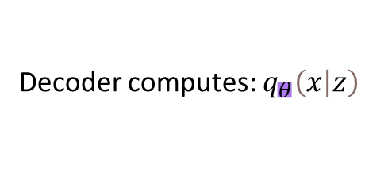
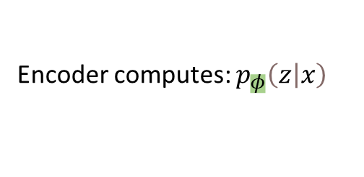
VAE optimization
$$x$$
$$x$$
$$μ$$
$$Z$$
$$σ$$
Encoder computes: $p_{φ}\left(\left.z\right|x\right)$
Decoder computes: $q_{θ}\left(\left.x\right|z\right)$
$ℒ\left(φ,θ, x\right)=$ (reconstruction loss) + (regularization term)

Slide 25
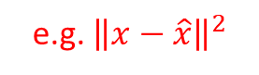
VAE optimization
e.g. ${\left\|x−\hat{x}\right\|}^{2}$
$$x$$
$$x$$
$$μ$$
$$Z$$
$$σ$$
Encoder computes: $p_{φ}\left(\left.z\right|x\right)$
Decoder computes: $q_{θ}\left(\left.x\right|z\right)$
$ℒ\left(φ,θ, x\right)=$ (reconstruction loss) + (regularization term)

Slide 26

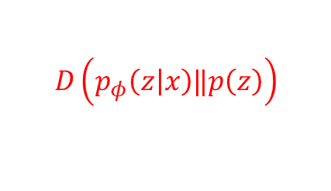
VAE optimization
Inferred latent distribution
Fixed prior on latent distribution
$x$
$$D\left(p_{φ}\left(\left.z\right|x\right)‖p\left(z\right)\right)$$
$$x$$
$$μ$$
$$Z$$
$$σ$$
Encoder computes: $p_{φ}\left(\left.z\right|x\right)$
Decoder computes: $q_{θ}\left(\left.x\right|z\right)$
$ℒ\left(φ,θ, x\right)=$ (reconstruction loss) + (regularization term)

Slide 27
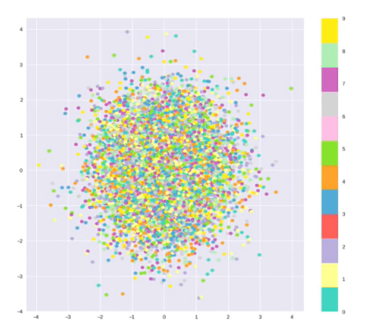
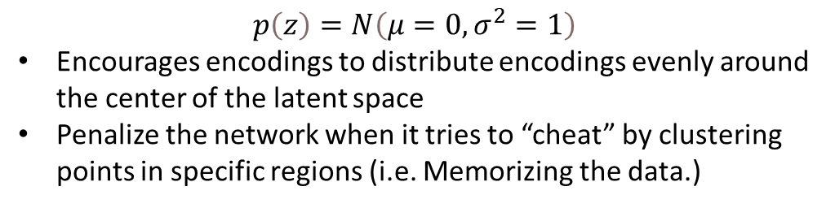
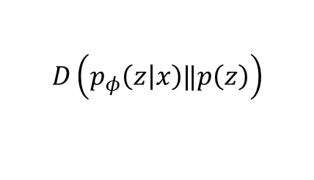
Priors on the latent distribution
$$D\left(p_{φ}\left(\left.z\right|x\right)‖p\left(z\right)\right)$$
Inferred latent distribution
Fixed prior on latent distribution
Common choice of prior:
$$p\left(z\right)=N\left(μ=0,σ^{2}=1\right)$$
Encourages encodings to distribute encodings evenly around the center of the latent space
Penalize the network when it tries to “cheat” by clustering points in specific regions (i.e. Memorizing the data.)

Slide 28
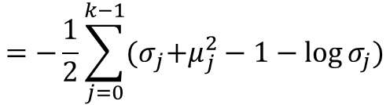
Priors on the latent distribution
$$D\left(p_{φ}\left(\left.z\right|x\right)‖p\left(z\right)\right)$$
KL-divergence between the two distributions
$$=−\frac{1}{2}\sum_{j=0}^{k−1}{{(σ}_{j}+μ_{j}^{2}−1−\log{σ_{j})}}$$
Common choice of prior:
$$p\left(z\right)=N\left(μ=0,σ^{2}=1\right)$$
Encourages encodings to distribute encodings evenly around the center of the latent space
Penalize the network when it tries to “cheat” by clustering points in specific regions (i.e. Memorizing the data.)

Slide 29
VAEs computation graph
$x$
$$x$$
$$μ$$
$$Z$$
$$σ$$
Encoder computes: $p_{φ}\left(\left.z\right|x\right)$
Decoder computes: $q_{θ}\left(\left.x\right|z\right)$
$ℒ\left(φ,θ, x\right)=$ (reconstruction loss) + (regularization term)

Slide 30
VAEs computation graph
Problem: We cannot backpropagate gradients through sampling layers
$$x$$
$$x$$
$$μ$$
$$Z$$
$$σ$$
Encoder computes: $p_{φ}\left(\left.z\right|x\right)$
Decoder computes: $q_{θ}\left(\left.x\right|z\right)$
$ℒ\left(φ,θ, x\right)=$ (reconstruction loss) + (regularization term)

Slide 31
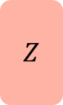
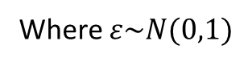
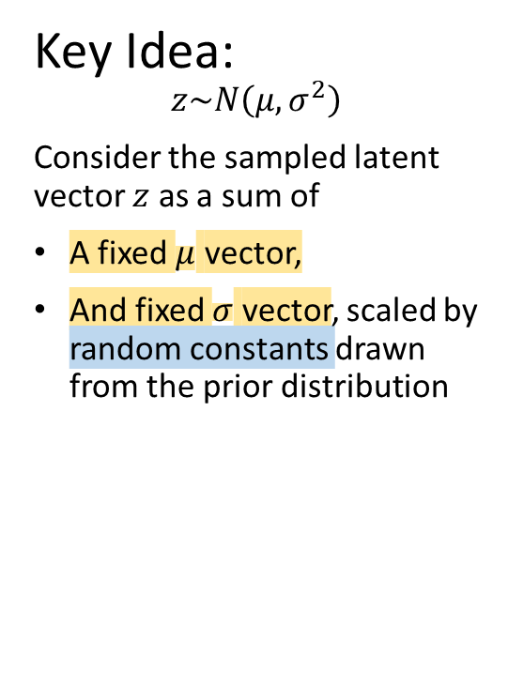
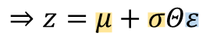
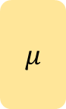

Reparametrizing the sampling layer
Key Idea:
$$z\sim N\left(μ,σ^{2}\right)$$
Consider the sampled latent vector $z$ as a sum of
A fixed $μ$ vector,
And fixed $σ$ vector, scaled by random constants drawn from the prior distribution
$$μ$$
$$Z$$
$$σ$$
$$⇒z=μ+σΘε$$
Where $ε\sim N(0,1)$

Slide 32
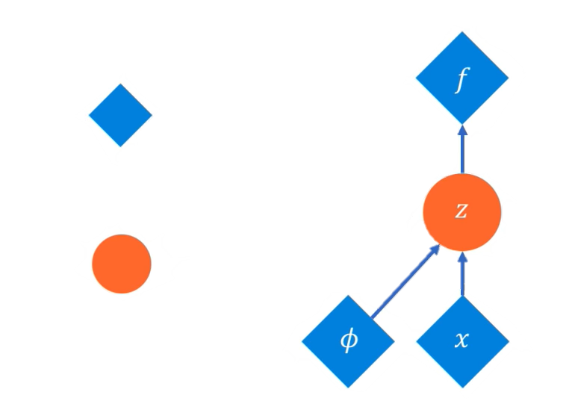
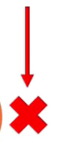
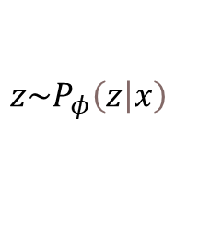
Reparametrizing the sample layer
Backprop
Deterministic node
$$z\sim P_{φ}\left(\left.z\right|x\right)$$
Stochastic node
Original form

Slide 33
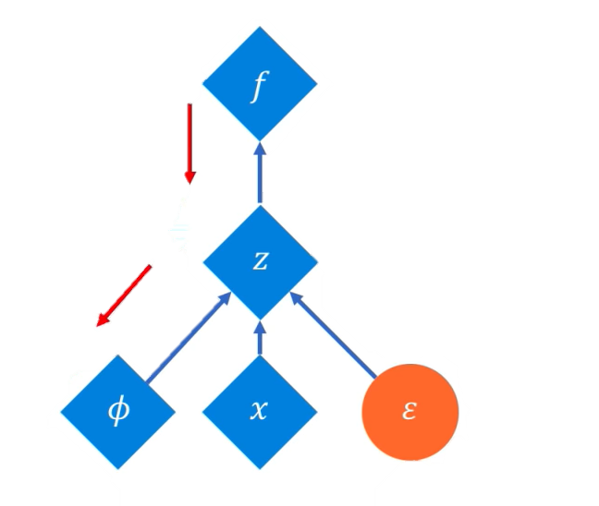
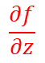
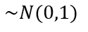
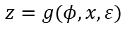
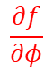
Reparametrizing the sampling layer
Backprop
Backprop
Deterministic node
$$\frac{∂f}{∂z}$$
$$z\sim P_{φ}\left(\left.z\right|x\right)$$
$$z=g(φ, x, ε)$$
$$\frac{∂f}{∂φ}$$
Stochastic node
$$\sim N(0,1)$$
Reparametrized form
Original form

Slide 34
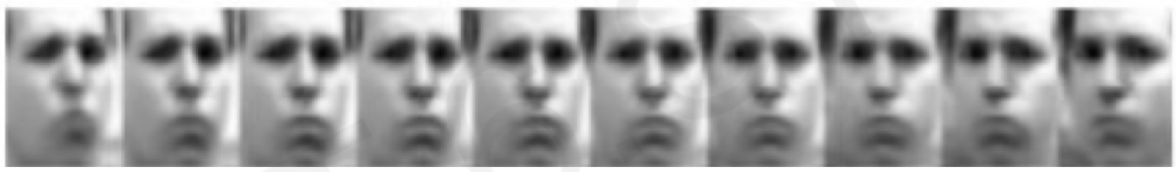
VAEs: Latent perturbation
Slowly increase or decrease a single latent variable
Keep all other variables fixed
Head pose
Different dimensions of z encodes different interpretable latent features

Slide 35



VAEs: Latent perturbation
Ideally, we want latent variables that are uncorrelated with each other
Enforce diagonal prior on the latent variables to encourage independence
Disentanglement
Smile
Head pose

Slide 36

Why generative models? Debiasing
Capable of uncovering underlying latent variables in a dataset
VS
Homogeneous skin color; pose
Diverse skin color; pose, illumination
How can we use latent distributions to create fair and representative datasets?

Slide 37







Mitigating bias through learned latent structure
$$x$$
$$x$$
$$Z$$
Learn Latent Structure

Slide 38




Mitigating bias through learned latent structure
$$x$$
$$x$$
$$Z$$
Homogeneous skin color; pose
Estimate distribution
Diverse skin color; pose, illumination

Slide 39






Mitigating bias through learned latent structure
$$x$$
$$x$$
$$Z$$
Adaptively resample data

Slide 40



Mitigating bias through learned latent structure
$$x$$
$$x$$
$$Z$$
Learn from fair data distribution
Latent distributions used to create fair and representative dataset

Slide 41



VAE summary
Compress representation of world to something we can use to learn
$$x$$
$$x$$
$$Z$$

Slide 42
VAE summary
Compress representation of world to something we can use to learn
Reconstruction allows for unsupervised learning (no labels)
$$x$$
$$x$$
$$Z$$

Slide 43
VAE summary
Compress representation of world to something we can use to learn
Reconstruction allows for unsupervised learning (no labels)
Reparameterization trick to train end-to-end
$$x$$
$$x$$
$$Z$$

Slide 44
VAE summary
Compress representation of world to something we can use to learn
Reconstruction allows for unsupervised learning (no labels)
Reparameterization trick to train end-to-end
Interpret hidden latent variables using perturbation
$$x$$
$$x$$
$$Z$$

Slide 45
VAE summary
Compress representation of world to something we can use to learn
Reconstruction allows for unsupervised learning (no labels)
Reparameterization trick to train end-to-end
Interpret hidden latent variables using perturbation
Generating new examples
$$x$$
$$x$$
$$Z$$

Slide 46
Generative Adversarial Networks (GANs)

Slide 47



What if we just want to sample?
Idea: don’t explicitly model density, and instead just sample to generate new instances.
Problem: want to sample from complex distribution – can’t do this directly
Solution: sample from something simple (noise), learn a
transformation to the training distribution
$$Z$$
$$G$$
$$X_{fake}$$
“fake” sample from the training distribution
noise
Generator Network G

Slide 48






Generative Adversarial Networks (GANs)
Generative Adversarial Networks (GANs) are a way to make a generative model by having two neural networks compete with each other
The discriminator tries to identify real data from fakes created by the generator
$$X_{real}$$
The generator turns noise into an imitation of the data to try to trick the discriminator.
$$D$$
$$y$$
$$Z$$
$$G$$
$$X_{fake}$$
noise

Slide 49

Intuition behind GANs
Generator starts from noise to try to create an imitation of the data.
Generator
Fake data

Slide 50

Intuition behind GANs
Discriminator looks at both real data and fake data created by the generator.
Discriminator
Generator
Fake data

Slide 51

Intuition behind GANs
Discriminator looks at both real data and fake data created by the generator.
Discriminator
Generator
Real data
Fake data

Slide 52

Intuition behind GANs
Discriminator tries to predict what’s real and what’s fake.
Discriminator
Generator
$P$(real) = 1
Real data
Fake data

Slide 53
Intuition behind GANs
Discriminator tries to predict what’s real and what’s fake.
Discriminator
Generator
$P$(real) = 1
Real data
Fake data

Slide 54
Intuition behind GANs
Discriminator tries to predict what’s real and what’s fake.
Discriminator
Generator
$P$(real) = 1
Real data
Fake data

Slide 55
Intuition behind GANs
Discriminator tries to predict what’s real and what’s fake.
Discriminator
Generator
$P$(real) = 1
Real data
Fake data

Slide 56
Intuition behind GANs
Generator tries to improve its imitation of the data.
Discriminator
Generator
$P$(real) = 1
Real data
Fake data

Slide 57
Intuition behind GANs
Generator tries to improve its imitation of the data.
Discriminator
Generator
$P$(real) = 1
Real data
Fake data

Slide 58
Intuition behind GANs
Generator tries to improve its imitation of the data.
Discriminator
Generator
$P$(real) = 1
Real data
Fake data

Slide 59
Intuition behind GANs
Discriminator tries to predict what’s real and what’s fake.
Discriminator
Generator
$P$(real) = 1
Real data
Fake data

Slide 60
Intuition behind GANs
Discriminator tries to predict what’s real and what’s fake.
Discriminator
Generator
$P$(real) = 1
Real data
Fake data

Slide 61
Intuition behind GANs
Discriminator tries to predict what’s real and what’s fake.
Discriminator
Generator
$P$(real) = 1
Real data
Fake data

Slide 62
Intuition behind GANs
Discriminator tries to predict what’s real and what’s fake.
Discriminator
Generator
$P$(real) = 1
Real data
Fake data

Slide 63
Intuition behind GANs
Generator tries to improve its imitation of the data.
Discriminator
Generator
$P$(real) = 1
Real data
Fake data

Slide 64
Intuition behind GANs
Generator tries to improve its imitation of the data.
Discriminator
Generator
$P$(real) = 1
Real data
Fake data

Slide 65
Intuition behind GANs
Generator tries to improve its imitation of the data.
Discriminator
Generator
$P$(real) = 1
Real data
Fake data

Slide 66
Intuition behind GANs
Discriminator tries to identify real data from fakes created by the generator.
Generator tries to create imitations of data to trick the discriminator.
Discriminator
Generator
$P$(real) = 1
Real data
Fake data

Slide 67






Generating new data with GANs
After training, use generator network to create new data that’s never been seen before
$$X_{real}$$
$$D$$
$$y$$
$$Z$$
$$G$$
$$X_{fake}$$
noise

Slide 68



Generating new data with GANs
After training, use generator network to create new data that’s never been seen before
$$X_{real}$$
$$D$$
$$y$$
$$Z$$
$$G$$
$$X_{fake}$$
noise

Slide 69
GANs: Recent Advances

Slide 70

Progressive growing of GANs (NVIDIA)
Latent
Latent
Latent
4x4
4x4
4x4
8x8
1024x1024
Reals
Reals
Reals
1024x1024
8x8
4x4
4x4
4x4
Training progresses

Slide 71

Progressive growing of GANs: results
© Alexander Amini and Ava Soleimany MIT 6.S191: Introduction to Deep Learning IntroToDeepLearning.com

Slide 72








CycleGAN: domain transformation
CycleGAN learns transformations across domains with unpaired data.
$$D_{x}$$
$$D_{y}$$
$$G$$
$$X$$
$$Y$$
$$F$$

Slide 73

CycleGan: Transforming speech
Audio waveform (A)
Audio waveform (B)
Spectrogram image (A)
Spectrogram image (B)

Slide 74


Slide 75

Deep Generative Modeling: Summary
Autoencoders and Variational Autoencoders (VAEs)
Learn lower-dimensional latent space and sample to generate input reconstructions
Generative Adversarial Networks (GANs)
Competing generator and
discriminator networks

Slide 76
Supplemental Slide

Slide 77

Training GANs
Discriminator tries to identify real data from fakes created by the generator:
Generator tries to create imitations of data to trick the discriminator.
Train GAN jointly via minimax game:
minmax$\left[{\text{𝔼}}_{x\sim p_{data}}\log{D_{θ_{d}}\left(x\right)+{\text{𝔼}}_{z\sim p\left(z\right)}\log{(1−D_{θ_{d}}(G_{θ_{g}}}(z)))}\right]$
Discriminator wants to maximize objectives s.t. $D(x)$ close to 1, $D(G\left(z\right))$ close to 0.
Generator wants to minimize objective s.t. $D(G\left(z\right))$close to 1.

